Slide 1
Chapter 15
Database Connectivity and Web Technologies

Slide 2
Learning Objectives
In this chapter, you will learn:
About database connectivity fundamentals
About various database connectivity technologies
How web-to-database middleware is used to integrate databases with the Internet
What services are provided by web application servers
What Extensible Markup Language (XML) is and why it is important for Web database development
About cloud computing and how it enables the database-as-a-service model

Slide 3
Database Connectivity
Database middleware: Provides an interface between the application program and the database
Data repository - Data management application used to store data generated by an application program
Universal Data Access (UDA): Collection of technologies used to access any type of data source and manage the data through a common interface
ODBC, OLE-DB, ADO.NET form the backbone of MS UDA architecture

Slide 4
Native SQL Connectivity
Connection interface provided by database vendors, which is unique to each vendor
Interfaces are optimized for particular vendor’s DBMS
Maintenance is a burden for the programmer

Slide 5
ODBC, DAO, and RDO
Open Database Connectivity (ODBC):Microsoft’s implementation of a superset of SQL Access Group Call Level Interface (CLI) standard for database access
Widely supported database connectivity interface
Allows Windows application to access relational data sources by using SQL via standard application programming interface (API)

Slide 6
ODBC, DAO, and RDO
Data Access Objects (DAO): Object-oriented API used to access desktop databases such as MS Access and FileMaker Pro
Provides an optimized interface that expose functionality of Jet data engine to programmers
DAO interface can be used to access other relational style data sources

Slide 7
ODBC, DAO, and RDO
Remote Data Objects (RDO)
Higher-level object-oriented application interface used to access remote database servers
Dynamic-link libraries (DLLs)
Implements ODBC, DAO, and RDO as shared code that is dynamically linked to the Windows operating environment

Slide 8
Components of ODBC Architecture
High-level ODBC API through which application programs access ODBC functionality
Driver manager that is in charge of managing all database connections
ODBC driver that communicates directly to DBMS

Slide 9
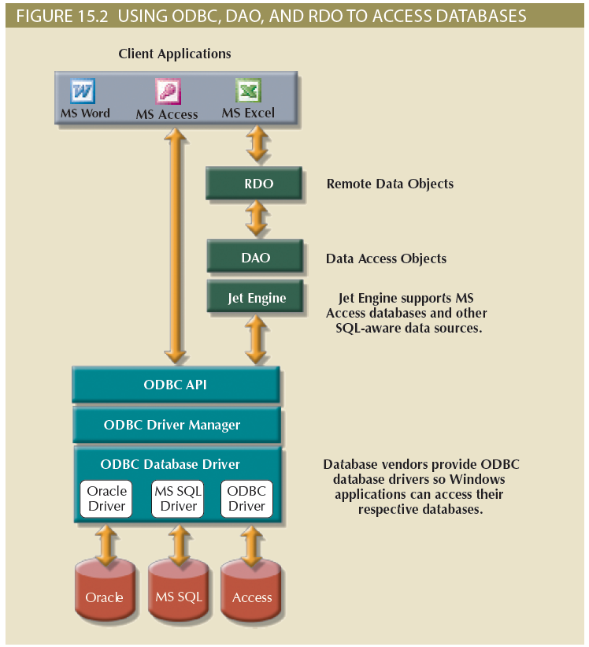
Figure 15.2 - Using ODBC, DAO, and RDO to Access Databases

Slide 10
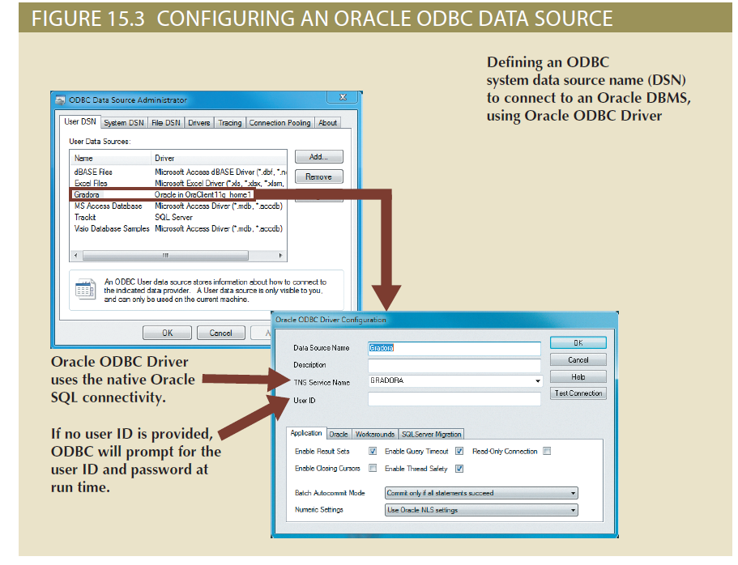
Figure 15.3 - Configuring an Oracle Data Source

Slide 11
Object Linking and Embedding for Database (OLE-DB)
Database middleware that adds object-oriented functionality for access to data
Series of COM objects provides low-level database connectivity for applications
Types of objects based on functionality
Consumers (applications or processes)
Providers (data or service)

Slide 12
Object Linking and Embedding for Database (OLE-DB)
Does not provide support for scripting languages
ActiveX Data Objects (ADO) provides:
High-level application-oriented interface to interact with OLE-DB, DAO, and RDO
Unified interface to access data from any programming language that uses the underlying OLE-DB objects

Slide 13
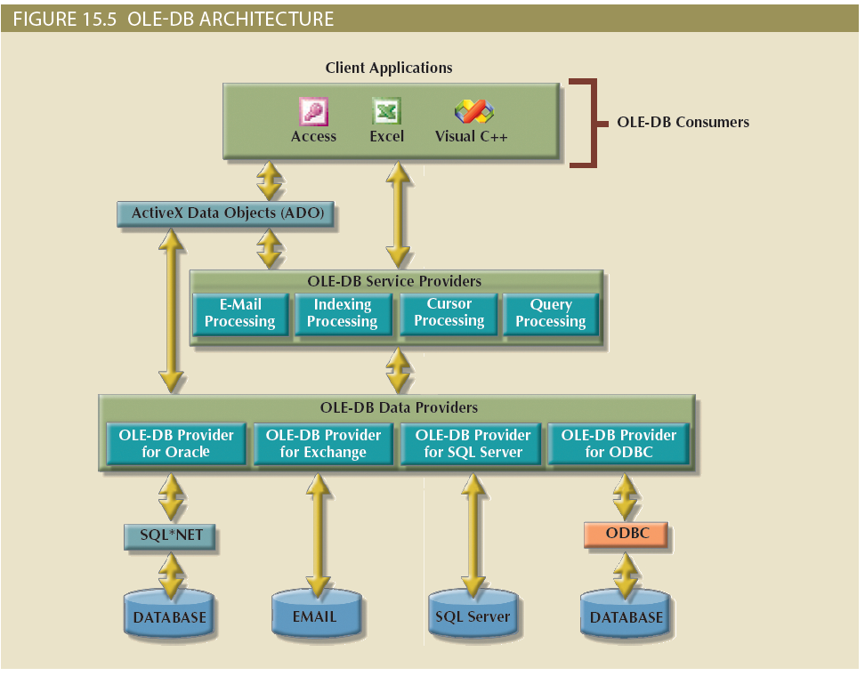
Figure 15.5 - OLE-DB Architecture

Slide 14
ADO.NET
Data access component of Microsoft’s .NET application development framework
Microsoft’s .NET framework
Component-based platform for developing distributed, heterogeneous, interoperable applications
Manipulates any type of data using any combination of network, operating system, and programming language
Extends and enhances functionality critical for the development of distributed applications

Slide 15
ADO.NET
DataSet: Disconnected memory-resident representation of the database
Contains tables, columns, rows, relationships and constraints
Internally stored in XML format
Data in DataSet is made persistent as XML documents

Slide 16
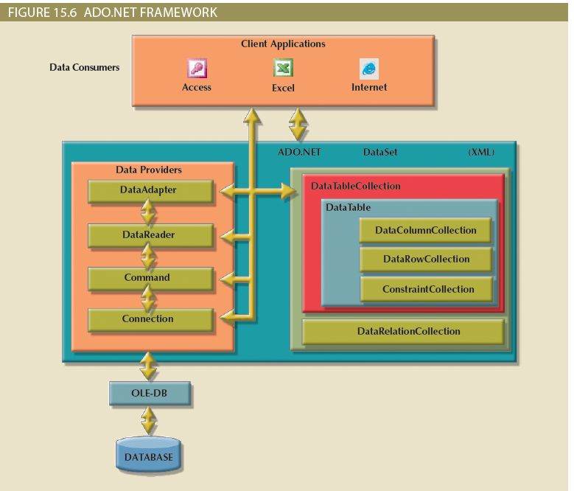
Figure 15.6 - ADO.NET Framework

Slide 17
Java Database Connectivity (JDBC)
Application programming interface that allows a Java program to interact with a wide range of data sources
Advantages of JDBC:
Company can leverage existing technology and personnel training
Allows direct access to database server or access via database middleware
Allows programmers to use their SQL skills to manipulate the data in the company's databases
Provides a way to connect to databases through an ODBC driver

Slide 18
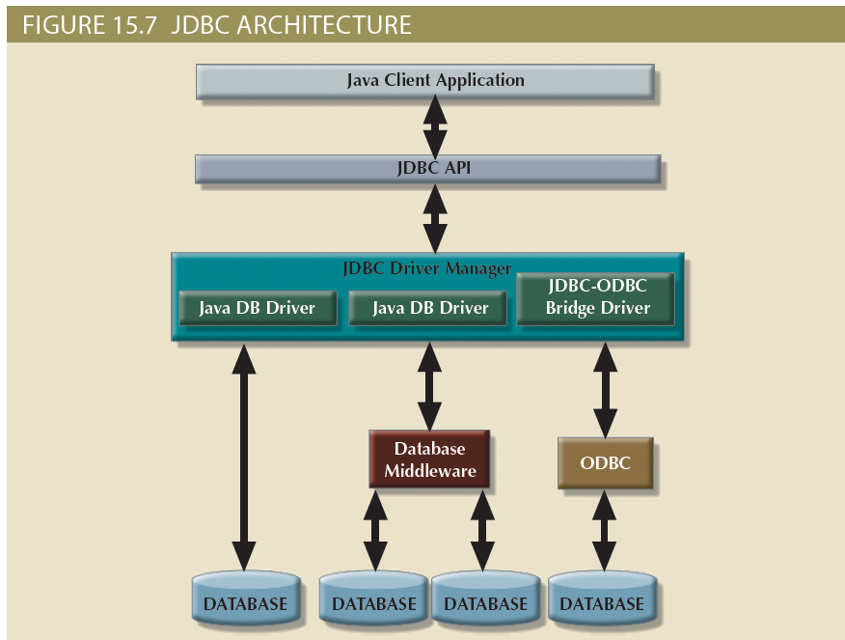
Figure 15.7 - JDBC Architecture

Slide 19
Database Internet Connectivity
Allows new innovative services that:
Permit rapid response by bringing new services and products to market quickly
Increase customer satisfaction through creation of web-based support services
Allow anywhere, anytime data access using mobile smart devices via the Internet
Yield fast and effective information dissemination through universal access

Slide 20
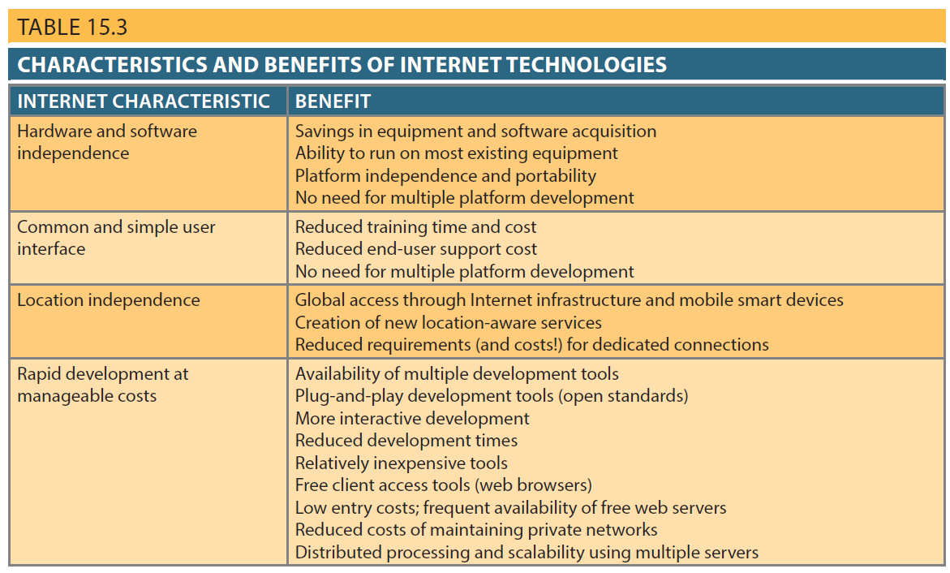
Table 15.3 - Characteristics and Benefits of Internet Technologies

Slide 21
Web-to-Database Middleware
Web server is the main hub through which Internet services are accessed
Server-side extension: Program that interacts directly with the web server
Provides its services to the web server in a way that is totally transparent to the client browser
Known as web-to-database middleware

Slide 22
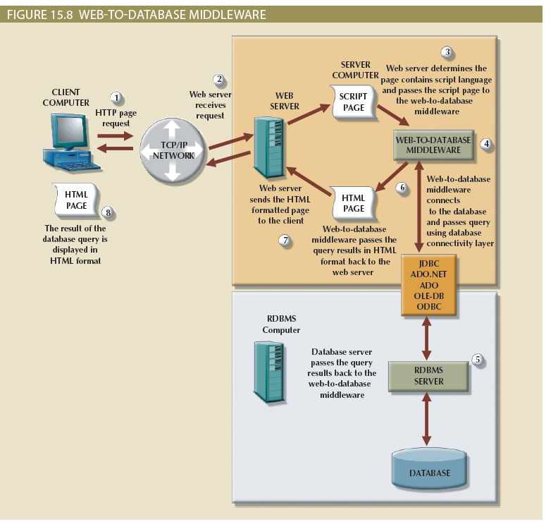
Figure 15.8 - Web-to-Database Middleware

Slide 23
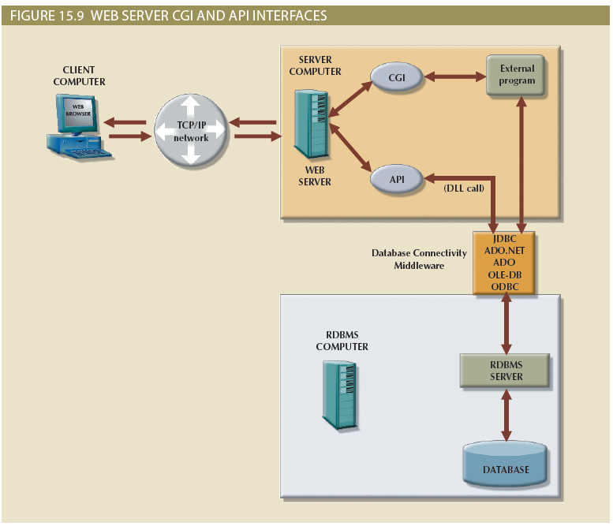
Figure 15.9 - Web Server CGI and API Interfaces

Slide 24
The Web Browser
Software that lets users navigate the web from their client computer
Interprets HTML code received from web server
Presents different page components in standard way
Web is a stateless system
Stateless system: Web server does not know the status of any clients

Slide 25
Client-Side Extensions
Add functionality to Web browser
Types
Plug-in: External application automatically invoked by the browser when needed
Java and JavaScript: Embedded in web page
Downloaded with the Web page and activated by an event
ActiveX and VBScript: Embedded in web page
Downloaded with page and activated by event
Oriented to Windows applications

Slide 26
Web Application Servers
Middleware application that expands the functionality of web servers by linking them to a wide range of services
Used to:
Connect to and query database from web page
Present database data in a webpage using various formats
Create dynamic web search pages
Create webpages to insert, update and delete data
Enforce referential integrity
Use simple and nested queries and program logic to represent business rules

Slide 27
Web Application Server Features
Integrated development environment
Security and user authentication
Computational languages
Automation generation of HTML pages
Performance and fault -tolerant features
Database access with transaction management capabilities
Access to multiple services

Slide 28
Web Database Development
Process of interfacing databases with the web browser
Code examples
ColdFusion
PHP

Slide 29
Extensible Markup Language (XML)
Represents and manipulates data elements
Facilitates the exchange of structured documents over the Web
Characteristics:
Allows definition of new tags
Case sensitive
Must be well-formed and properly nested
Comments indicated with <- and ->
XML and xml prefixes reserved for XML tags only

Slide 30
Document Type Definitions (DTD)
File with .dtd extension that describes elements
Provides composition of database’s logical model
Defines the syntax rules or valid tags for each type of XML document
Companies engaging in e-commerce transaction must develop and share DTDs
DTD referenced from inside XML document

Slide 31
XML Schemas
Advanced data definition language
Describes the structure of XML data documents
Advantage
More closely maps to database terminology and features
XML schema definition (XSD): File uses syntax similar to XML document

Slide 32
XML Presentation
XML separates data structure from presentation and processing
Extensible Style Language (XSL) displays XML data
Defines the rules by which XML data are formatted and displayed
Parts:
Extensible Style Language Transformations (XSLT)
XSL style sheets

Slide 33
XML Applications
B2B exchanges
Legacy systems integration
Web page development
Database support
Database meta-dictionaries
XML databases
XML services

Slide 34
Cloud Computing Services
Computing model that enables access to a shared pool of configurable computer resources that can be:
Rapidly provisioned
Released with minimal management effort or service provider interaction
Potential to become a game changer
Eliminates financial and technological barriers

Slide 35
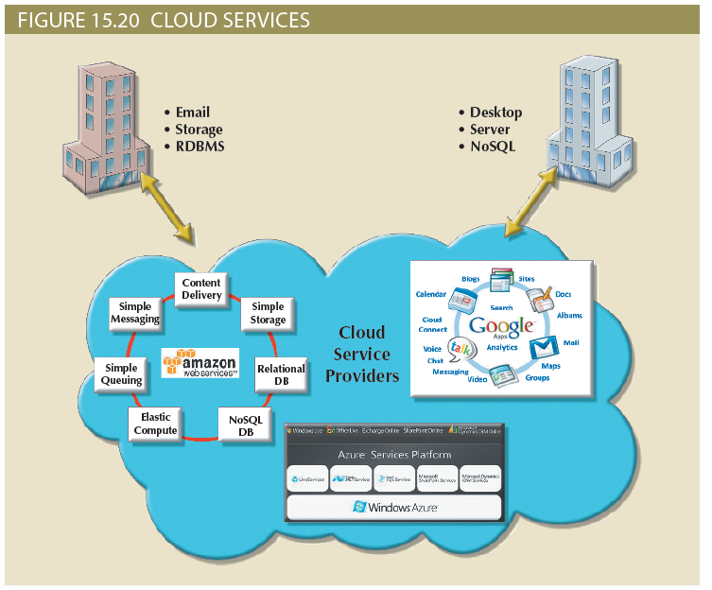
Figure 15.20 - Cloud Services

Slide 36
Cloud Implementation Types
Public cloud
Private cloud
Community cloud
Built by a third-party organization to sell cloud services to the general public
Built by an organization for the sole purpose of servicing its own needs
Built by and for a specific group of organizations that share a common trade

Slide 37
Characteristics of Cloud Services
Ubiquitous access via Internet technologies
Shared infrastructure
Lower costs and variable pricing
Flexible and scalable services
Dynamic provisioning
Service orientation
Managed operations

Slide 38
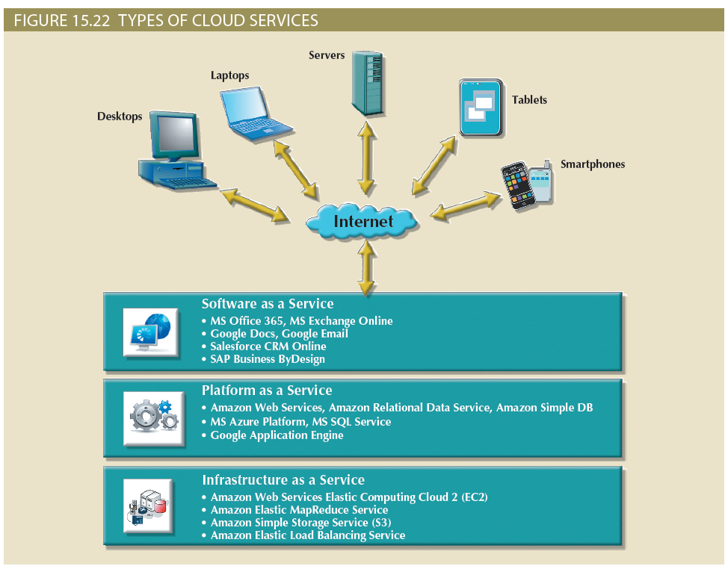
Figure 15.22 - Types of Cloud Services

Slide 39
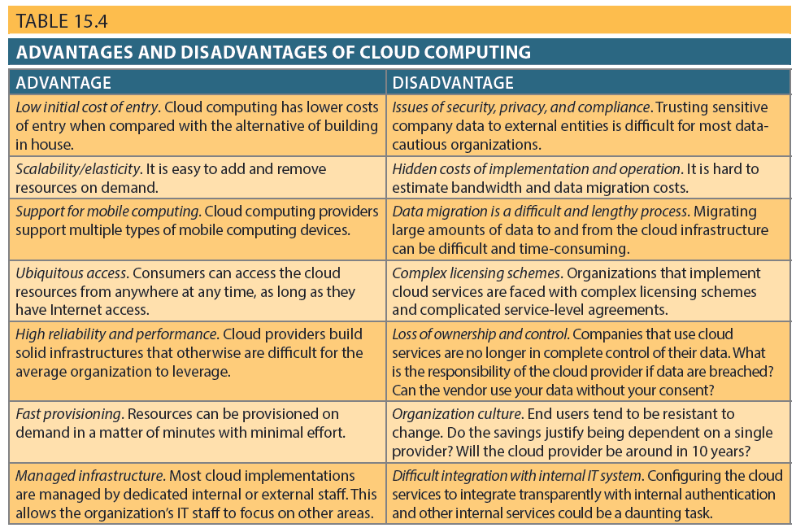
Table 15.4 – Advantages and Disadvantages of Cloud Computing

Slide 40
SQL Data Services
Cloud computing-based data management service
Provides relational data management to companies
Hosted data management and standard protocols
Common programming interface
Advantages:
Reliable and scalable at a lower cost than in-house systems
High level of fault tolerance
Dynamic and automatic load balancing, automated data backup and disaster recovery are included
Dynamic creation and allocation of processes and storage

